Slide 1



^{Re-Direction Staff Training}
Workshop on ICT Skills: Introducing AI in Higher Education
12th of November 2025
Assoc. Prof. P. Papadopoulos

Slide 2

rEMINDER
-1
Unfair between students that have a paid/upgraded version: Different AI tools are better at different things, so the paid version of one might be inferior to the free of another
A survey of educators showed that that their main concern was how to utilize AI tools for preparing their material, while this presentation is from the student-learning perspective

Slide 3

Workshop on ICT Skills
1
A few words about the presenter
Dr. P. Papadopoulos
Assoc. Prof at the Department of Mechanical Engineering and Aeronautics, University of Patras, Greece.
Interests: Computational Fluid Dynamics, Applied Mathematics
One of the courses I teach:
“Numerical Methods for Partial Differential Equations”
Elective course in the 9th Semester.
It includes 5 coding projects of solving PDEs numerically.

Slide 4
Workshop on ICT Skills
1
A few words about the presentation
Motivation:
Generative AI is the new norm.
Can it be incorporated in the teaching process in higher education?
How does it affect traditional lecturing and student evaluation?
Topics:
Why AI matters in Higher Education: Opportunities and misuses
Prompt Engineering: Strong vs Weak Prompting
All the ideas presented are part of work in progress to incorporate AI in the educational process

Slide 5

AI in higher Education
1
Why AI matters in Higher Education
Opportunities and misuses of AI for Students

Slide 6

AI in Education
1
Why AI matters in Higher Education
Students already use LLMs (Large Language Models - ChatGPT, Copilot, Gemini…) daily.
AI can accelerate learning, writing, coding, translating.
Potential to personalize learning and support diverse learners.
Universities need to guide use, not prohibit.
Teaching AI = preparing students for the future workforce.

Slide 7

AI in Education
1
In 2–3 words, which part of the educational process has AI changed most for you?
https://www.menti.com/alh1ti1vtzpn

Slide 8
AI in Education
1
Opportunities of AI for Students
Risks & Misuses of AI
Faster access to knowledge (but needs evaluation)
Inclusivity (assistive tech, multilingual learning)
Reduces unnecessary workload
Drafting texts, solving problems, generating ideas
Coding & debugging support
Copy–paste plagiarism
Hallucinations & unreliable outputs
Bias and ethics concerns
Over-reliance → reduced critical thinking

Slide 9

AI in Education
1
Prompt Engineering as a New Literacy
Definition: designing effective inputs to get useful outputs from ΑΙ
Comparison: search queries (Google) vs prompts (AI)
Key skills: clarity, context, iteration
The Role of Academic Staff
Teaching correct use of LLMs
Setting rules and academic integrity standards
Developing students’ AI literacy

Slide 10

AI in Education
1
“Correct" ways of incorporating AI tools in the educational process
1. Core principles for responsible LLM use
Transparency first: Students must disclose where, how, and why they used an LLM. No AI-use detectors. Assess work and process instead.
Human accountability: Students own the final output. AI is an assistant, not the author.
Grounding in sources: Any factual claims must be verifiable from cited human-authored sources (library databases, textbooks, datasets).

Slide 11

AI in Education
1
“Correct" ways of incorporating AI tools in the educational process
2. Allowed use “tiers”
Tier 0 – Prohibited: LLMs may not produce final deliverables (e.g., final essay text, full code submission) unless explicitly allowed.
Tier 1 – Assistive (disclose): Brainstorming, outlining, language polishing, generating study questions, translating students’ own text.
Tier 2 – Collaborative (disclose + verify): Drafting sections, code stubs, or analysis plans with mandatory verification & reflection.
Tier 3 – Co-creation (explicitly permitted + audit trail): AI can co-write or co-code; students must submit an audit trail and defend decisions orally.

Slide 12

AI in Education
1
“Correct" ways of incorporating AI tools in the educational process
3. What to require from students
Prompt log (key prompts).
Verification notes (links to sources, unit tests, calculations, or checks).
Reflection (what the AI got wrong, how they fixed it, what they learned).

Slide 13
AI in Education
1
“Correct" ways of incorporating AI tools in the educational process
4. How to build AI-aware assessments
Process > product: Grade the reasoning trail + verification, not just the final output.
Oral defense: 5–7 min on any section the LLM touched.
Coherent structure in writing: Essays should not be a stitch of relevant data, but present a clear, cumulative line of reasoning.
Assignment prompts that resist copy-paste AI use: Do not give step-by-step instructions that can be pasted into an LLM. Instead, set high-level goals that require students to synthesize course concepts, lecture notes, and class-specific materials to build the essay.

Slide 14
Prompt Engineering
2
Strong vs Weak Prompting
Example Using the Case Studies

Slide 15


Prompt Engineering
2
Weak vs Strong start promp
Weak: “Write my essay on sustainability”
Strong: “Create an outline for an essay on EU Green Deal. Highlight 3 challenges for HEIs, with references to EU strategies.”
Lesson: The more specific the prompt, the more useful the output
Source checking: The student must verify the sources

Slide 16
Prompt Engineering
2
Instructions to students
1. You have instructions and a template. Before you continue with prompting you must carefully study all the plan steps
2. Answer the questions the tool made. Tell the tool to either
  help you step by step to achieve the plan or
  address the problems and questions you had about every plan step.
3. You can use the deep search function of the AI tool to find datasets and create the bibliography.
4. You can use AI tools to find information, learn how to use other tools (like specialized programs) and help you understand new concepts.
We do NOT use AI to deliver ready to download files. AI is like a partner to brainstorm ideas.

Slide 17
Prompt Engineering
2
How to prompt efficiently
Give the AI tool clear instructions and a template on
  what you want it to do (e.g., create a summary, help you with an academic level essay, etc.)
  how to do it (few shot prompting).
2. Instead of starting new prompts, try to engage in conversational prompting
(a) try to guide the AI tool to the desired results
(b) if the prompting is too long or it strays away from your goal, start a new one adopting a different approach
(c) the AI tool has limited memory, so if the conversation is too long, it might disregard early prompts
3. Beware of hallucinations and biases
(a) provide proper context such as Wikipedia pages
(b) verify sources
(c) critically evaluate the results

Slide 18

Prompt Engineering
2
Immediate vs Continuous prompting
Immediate prompts: “Do this task” (e.g., translate this text)
Continuous prompts: “From now on suggest improved questions” (e.g., how does a car work, may refer to the engine, the car’s systems to the driving specifics)
It is always a good practice to provide the pattern to follow or give it an example.

Slide 19
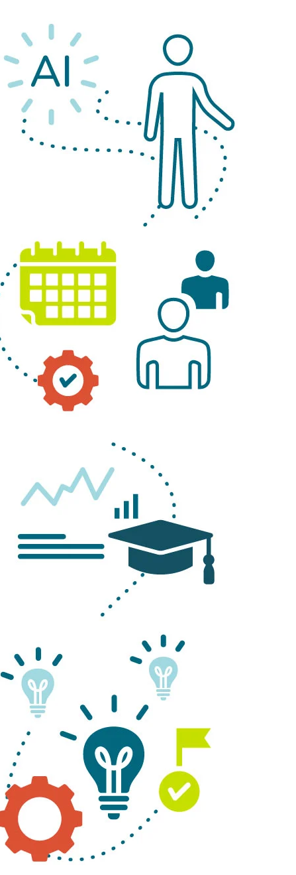
Prompt Engineering
2
Guiding the AI tool
A general question leads to a general answer
Give instructions like talking to your personal assistant:
  start form the general question
  refine it as it goes
  give additional information
  do not give conflicting information
  do not give instructions that you have not considered their consequences

Slide 20

Prompt Engineering
2
Word patterns
A certain sequence of words will lead to specific results, e.g.
  the prompt “space is the final frontier”
  leads to the answer “It sure is! The phrase "Space, the final frontier" is iconic, often associated with Star Trek.”
A different sequence might lead to different results
  the prompt “the universe is boundless frontier waiting to be explored”
  leads to the answer “Absolutely, the universe is like an endless canvas, filled with mysteries and wonders just waiting for us to uncover.”

Slide 21
Prompt Engineering
2
Conclusions
Anchor to course: name the framework, readings/data, and constraints.
Structure prompts: Role → Task → Constraints → Sources → Output format.
Show a mini example (few-shot) to set tone/quality.
Decompose: ask for a checklist/outline first, then draft.
Verification built-in: require claims + evidence needed, uncertainties, and citations/tests.
Iterate: critique → revise loop (brief, targeted).

Slide 22
References
A
Dr. Jules White, Vanderbilt University, Coursera course on “Prompt Engineering Specialization” (https://www.coursera.org/specializations/prompt-engineering)
https://www.usa.edu/blog/ai-in-higher-education-how-ai-is-reshaping-higher-education/
ChatGPT (https://chatgpt.com/)

Slide 23


