Slide 1

Contributing to a Sustainable Future
Section 2: Decision-Making for Sustainability

Slide 2

Introduction

Slide 3

Learning Objectives:
Understanding the role of decision-making in sustainable development.
Identifying common challenges in making sustainable decisions.
Applying decision-making tools and frameworks.
Evaluating decisions using a sustainability lens.

Slide 4
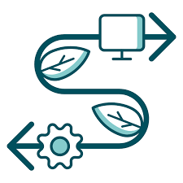
Why Does Decision-Making Matter?
Every decision impacts people, planet, and profit (Triple Bottom Line).
Today’s choices shape future generations’ opportunities.
Sustainability requires systematic, thoughtful, and ethical decision-making.

Slide 5

Common Challenges in Decision-Making
Information overload
Conflicting priorities (e.g., profit vs. environment)
Short-term thinking
Lack of stakeholder inclusion
Ethical dilemmas

Slide 6
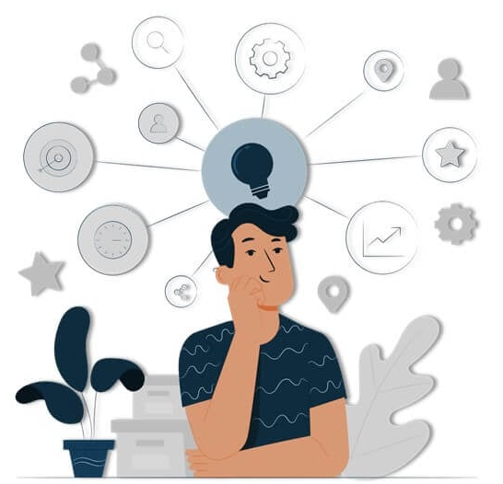
Areas of Decision-Making Competence
Critical Thinking
Systems Thinking
Ethical Reasoning
Collaboration and Communication
Futures Thinking

Slide 7
Tools Applied in Decision-Making

Slide 8

Framework: Triple Bottom Line (TBL)
People – Social impact
Planet – Environmental footprint
Profit – Economic feasibility
➡ Aim: Maximize value in all three
dimensions

Slide 9

Tool: Cost-Benefit Analysis (CBA)
Weighs financial and non-financial outcomes
Helps compare short-term gains vs. long-term impact
Must include externalities (e.g., carbon emissions, health costs)

Slide 10

Tool: Life-Cycle Thinking (LCT)
Considers a product or decision from creation to disposal
Helps identify hidden costs and impacts (e.g., e-waste, water use)
Supports eco-design and circular economy models
Notes:
A nursing student searching for reliable health articles.
A teaching student filtering lesson plan resources.
A CS student refining searches for AI research papers.

Slide 11

Tool: Sustainability Impact Assessment (SIA)
Structured process to evaluate social, environmental, and economic impacts of a decision or project
Includes stakeholder analysis, risk mapping, and mitigation planning
Notes:
A nursing student searching for reliable health articles.
A teaching student filtering lesson plan resources.
A CS student refining searches for AI research papers.

Slide 12
What You Will Learn in This Course

Slide 13

What This Course Offers You
Practical tools for evaluating and making responsible decisions
Opportunities to apply sustainability thinking in real-world contexts
Transferable decision-making skills for diverse careers
Insight into how your personal and professional choices impact society and the environment
A foundation for ethical leadership and critical problem-solving

Slide 14



Decision-Making in Different Fields
🔬 Medical Field
Balancing patient care, ethics, and resource use
Decisions on treatments, tech adoption, and public health policy
📚 Pedagogical Field
Designing inclusive and sustainable learning environments
Choosing curricula that support equity and long-term competence
💻 IT & Technology Field
Ethical use of data, AI, and automation
Sustainable tech development: energy, privacy, and long-term impacts
Notes:
Example: A student researching vaccines needs to distinguish scientific studies from misinformation.

Slide 15

Reflection Questions for Students
How do I balance my personal values with sustainability goals?
Have I considered unintended consequences?
Who benefits or is harmed by my choices?
What would a future generation say about this decision?
Notes:
Example: A student searching “Is AI dangerous?” might only see negative articles unless they adjust their search.

Slide 16

Conclusion & Takeaways
Sustainable decision-making is a lifelong skill
Requires ethical awareness, critical analysis, and holistic thinking
Your decisions today are investments in the future
Notes:
Example: A student researching vaccines needs to distinguish scientific studies from misinformation.

