Slide 1

Contributing to a Sustainable Future
Section 3: Innovation for Sustainable Solutions

Slide 2

Introduction

Slide 3
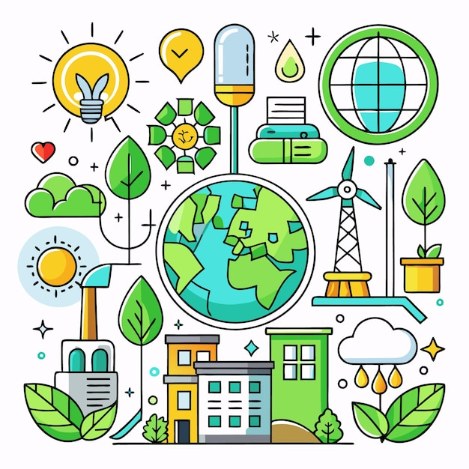
Learning Objectives:
Understanding the role of innovation in sustainability
Identify key challenges in sustainable innovation
Apply creative and design thinking to real-world sustainability problems
Analyze impactful case studies across energy, mobility, consumption, and circular economy

Slide 4

Why Does Innovation Matter for Sustainability?
Innovation creates new ways to meet human needs sustainably
It enables cleaner, smarter, and more efficient solutions
Supports the transition to low-carbon, inclusive economies
Drives change where traditional solutions have failed

Slide 5
What is Sustainable Innovation?
Innovation that improves social and environmental outcomes
Aligns with the UN Sustainable Development Goals (SDGs)
Can be technological, social, policy-based, or process-oriented
Often driven by interdisciplinary thinking and collaboration

Slide 6
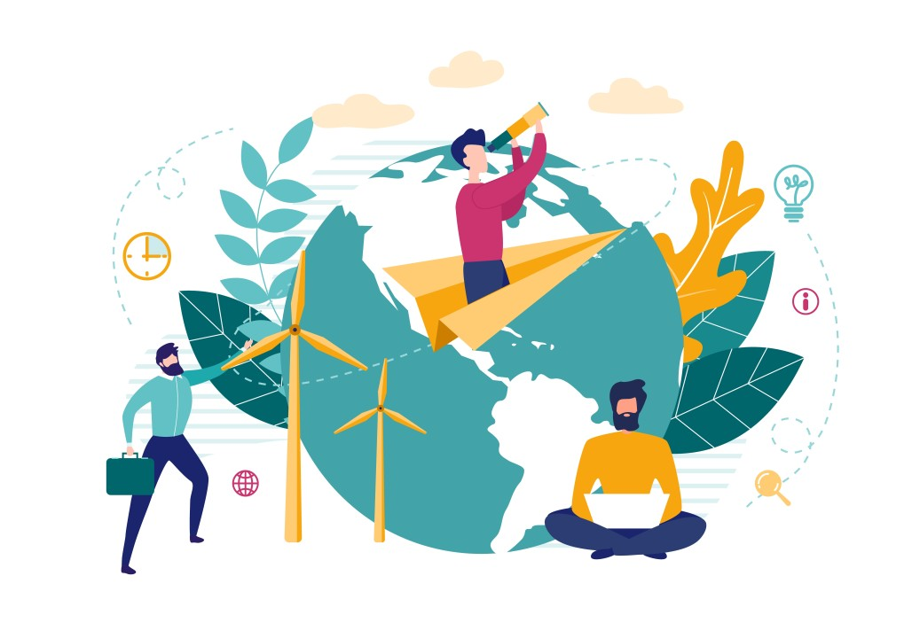
Examples of Sustainable Innovation
Solar-powered water purification (CleanTech)
Electric and shared mobility systems (MobilityTech)
Refillable packaging systems (Circular Design)
Vertical urban farming (AgriTech)

Slide 7

Common Challenges of Sustainable Innovation
High initial investment costs
Regulatory and policy barriers
Resistance to change or adoption
Balancing profitability with long-term sustainability
Lack of collaborative ecosystems

Slide 8
Tools Applied in Innovation for Sustainable Solutions

Slide 9
Creative Thinking for Sustainability
Generating original ideas by questioning assumptions
Using analogies, brainstorming, and problem reframing
Thinking beyond current market offerings or behaviors
Examples: Biomimicry, behavioral nudging, frugal innovation

Slide 10

What is Design Thinking?
Empathize – Understand user needs
Define – Frame the real problem
Ideate – Generate creative ideas
Prototype – Build quick versions
Test – Improve through feedback

Slide 11
Areas of Innovation for Sustainable Solutions Competence
Systems Thinking – Understanding interconnections
Empathy and Human-Centered Design
Cross-Disciplinary Collaboration
Iterative Problem-Solving
Entrepreneurship and Impact Orientation

Slide 12

Making Innovation Work
Tips for Students and Innovators:
Start small, test often
Collaborate across disciplines
Think globally, act locally
Measure environmental and social impact
Stay curious and keep learning

Slide 13
What You Will Learn in This Course

Slide 14
What This Course Offers You
Practical tools and frameworks to approach sustainability challenges
Real-world case studies in energy, mobility, and consumption
Creative thinking and design thinking techniques to drive innovation
Opportunities to collaborate across disciplines for impactful solutions
A deeper understanding of how innovation can align with sustainability goals

Slide 15



Innovation for Sustainable Solutions in Different Fields
🔬 Medical Field
Telemedicine innovations for healthcare access
Sustainable medical technologies (e.g., biodegradable implants, energy-efficient diagnostic equipment)
🏙 Urban Planning & Architecture
Green buildings, energy-efficient infrastructure
Smart cities powered by renewable energy, waste management solutions
🚗 Mobility & Transportation
Electric vehicles (EVs) and shared mobility solutions
Sustainable public transport systems
🍽 Food & Agriculture
Vertical farming and sustainable agriculture practices
Innovations in plant-based foods and food waste reduction

Slide 16
Innovation for Sustainable Solutions in Medicine
1. Environmentally responsible – reducing waste, energy use, or pollution (e.g., greener manufacturing of pharmaceuticals, reducing single-use plastics in hospitals).
2. Economically viable – affordable over the long term for both healthcare systems and patients.
3. Socially equitable – accessible and beneficial to diverse populations, including
underserved communities.
4. Long-term effective – not just focused on short-term breakthroughs, but designed to remain useful and relevant over time.

Slide 17

Reflection Questions for Students
How do I balance my personal values with sustainability goals?
Have I considered unintended consequences?
Who benefits or is harmed by my choices?
What would a future generation say about this decision?

Slide 18

Conclusion & Takeaways
🔹 Innovation is essential for solving global sustainability challenges
🔹 Design thinking and creativity are key tools
🔹 Every field and profession has a role to play
🔹 You can be a driver of positive change

