Slide 1

Contributing to a Sustainable Future
Section 6: Final Project: Sustainable Future Action Plan

Slide 2

Introduction

Slide 3

Learning Objectives:
Identify and analyze a real-world sustainability issue
Design and present a practical, impactful action plan
Collaborate, reflect, and integrate feedback
Build skills in planning, communication, and leadership

Slide 4

What This Section Offers You
A chance to apply theory in a practical context
Development of a professional-level sustainability project
Experience with problem-solving, planning, and leadership
Constructive peer and instructor feedback
A project that can enrich your portfolio or CV

Slide 5
Project Design

Slide 6

Project Design Steps
Define the problem
Research background & context
Propose a solution
Set clear goals & outcomes
Plan implementation steps
Identify resources & stakeholders
Consider impact & evaluation

Slide 7

Why Does Innovation Matter Here?
Traditional methods alone won't solve new sustainability challenges
Innovation helps create unique, scalable, adaptable solutions
Encourages interdisciplinary thinking and collaborative action
A creative mindset turns problems into opportunities for change

Slide 8

Common Challenges in Project Planning
⚠ Unclear goals
⚠ Limited time or funding
⚠ Difficulty engaging stakeholders
⚠ Balancing ambition with feasibility
⚠ Measuring long-term impact
Notes:
A nursing student searching for reliable health articles.
A teaching student filtering lesson plan resources.
A CS student refining searches for AI research papers.

Slide 9

Competence Areas for Innovation and Action
🔧 Design & planning skills
🧠 Systems thinking & critical reflection
🤝 Stakeholder engagement & collaboration
📊 Impact assessment & sustainability literacy
🎯 Leadership & initiative
Notes:
A nursing student searching for reliable health articles.
A teaching student filtering lesson plan resources.
A CS student refining searches for AI research papers.

Slide 10
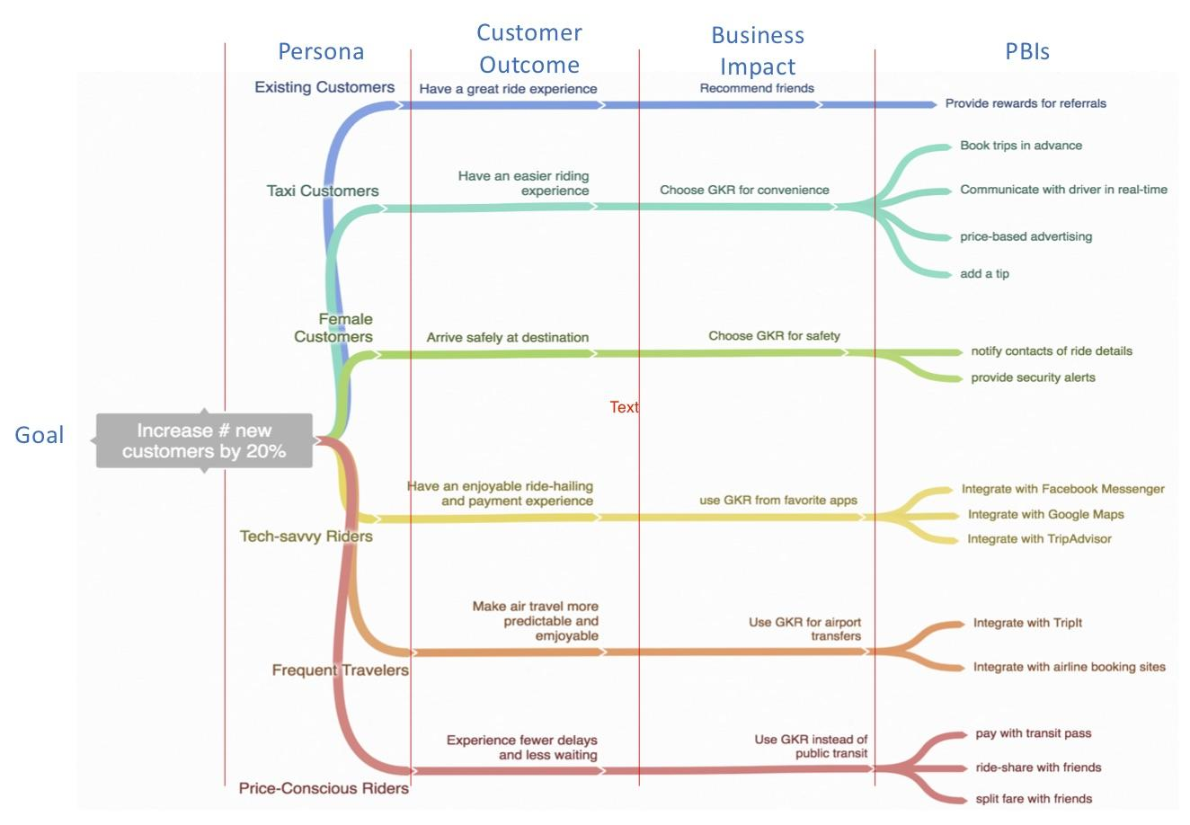
Mapping Impact
How will you know your project made a difference?
Define indicators of success
Consider short- and long-term effects
Use tools like:
  SWOT analysis
  Sustainability Impact Matrix
  Feedback surveys or interviews
Notes:
A nursing student searching for reliable health articles.
A teaching student filtering lesson plan resources.
A CS student refining searches for AI research papers.

Slide 11

Presentation & Peer Feedback
🎤 Share your plan with peers
✅ Receive suggestions and constructive feedback
🎯 Refine your idea before implementation
💬 Opportunity to practice communication and defend your choices
Notes:
A nursing student searching for reliable health articles.
A teaching student filtering lesson plan resources.
A CS student refining searches for AI research papers.

Slide 12

Final Deliverable Format
Your project can be submitted as:
A slide deck with visuals and explanations
A written action plan (2–4 pages)
A short video or recorded presentation
Include:
Problem statement
Proposed solution
Implementation steps
Stakeholder map
Resources
Expected outcomes
Notes:
A nursing student searching for reliable health articles.
A teaching student filtering lesson plan resources.
A CS student refining searches for AI research papers.

Slide 13
What You Will Learn in This Course

Slide 14
What This Course Offers You
A chance to apply theory in a practical context
Development of a professional-level sustainability project
Experience with problem-solving, planning, and leadership
Constructive peer and instructor feedback
A project that can enrich your portfolio or CV

Slide 15

Reflection Questions for Students
🧠 What sustainability issue are you passionate about?
🧩 How can your knowledge and skills contribute to a solution?
🌱 What would success look like for your project—and for the planet?
Notes:
Example: A student searching “Is AI dangerous?” might only see negative articles unless they adjust their search.

Slide 16

Conclusion & Takeaways
🔹 Innovation is essential for solving global sustainability challenges
🔹 Design thinking and creativity are key tools
🔹 Every field and profession has a role to play
🔹 You can be a driver of positive change
Notes:
Example: A student researching vaccines needs to distinguish scientific studies from misinformation.

